Slide 1

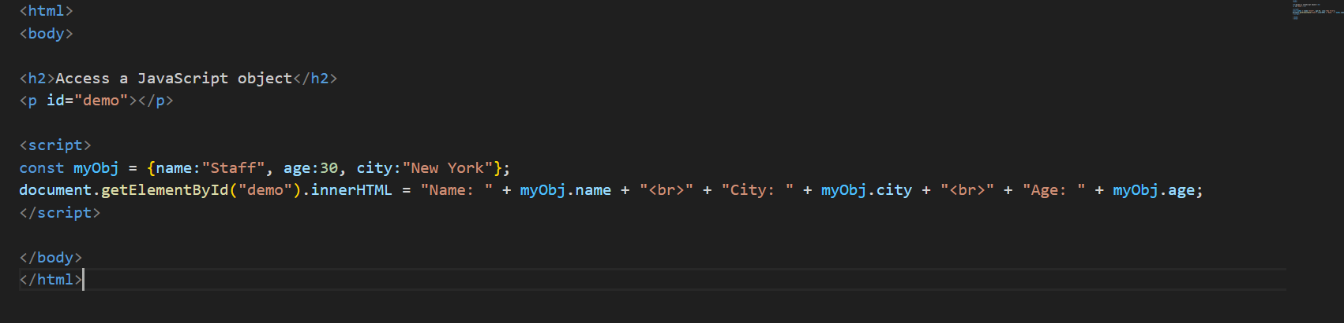
Objects
Object is used to updated demo by creating a html string from the objects value.

Slide 2
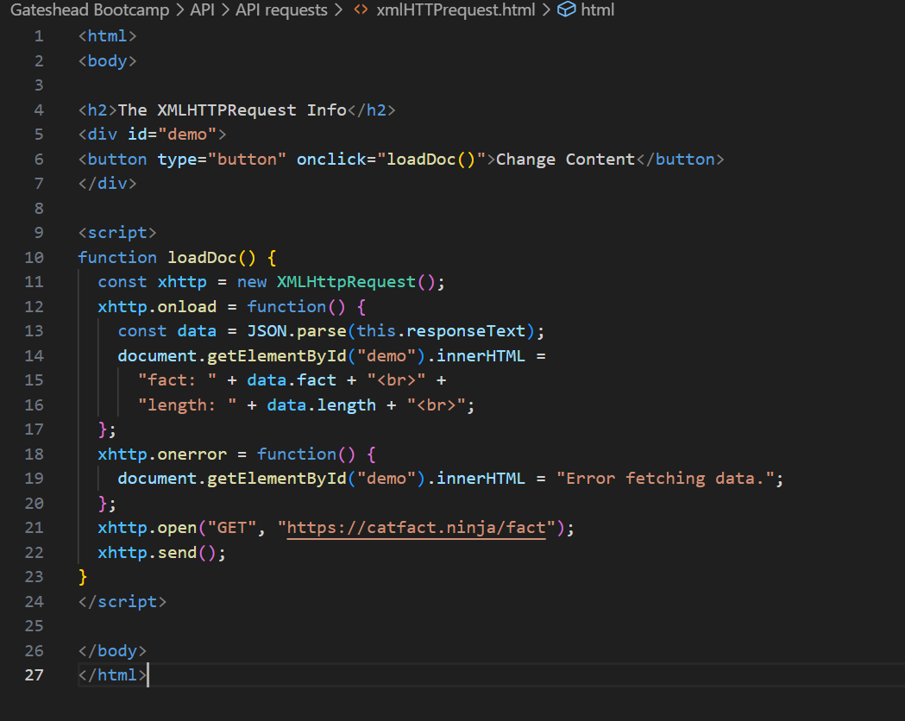
Retrieving
Includes a function that will take a response from a server convert into JSON and then accesses the 2 data properties and replaces the button in the demo and displays it on the website.

Slide 3
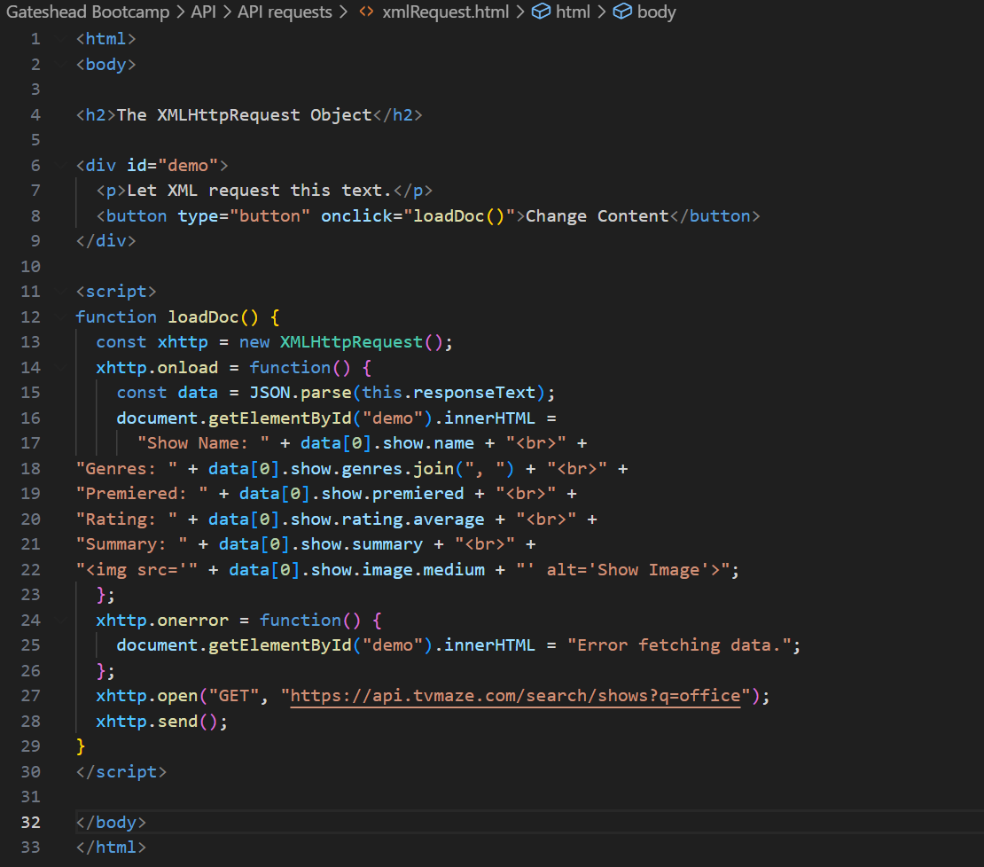
Retrieving
This is like the last side however instead returns an array of objects in Json and shows how to access nested objects and how to handle arrays.

Slide 4
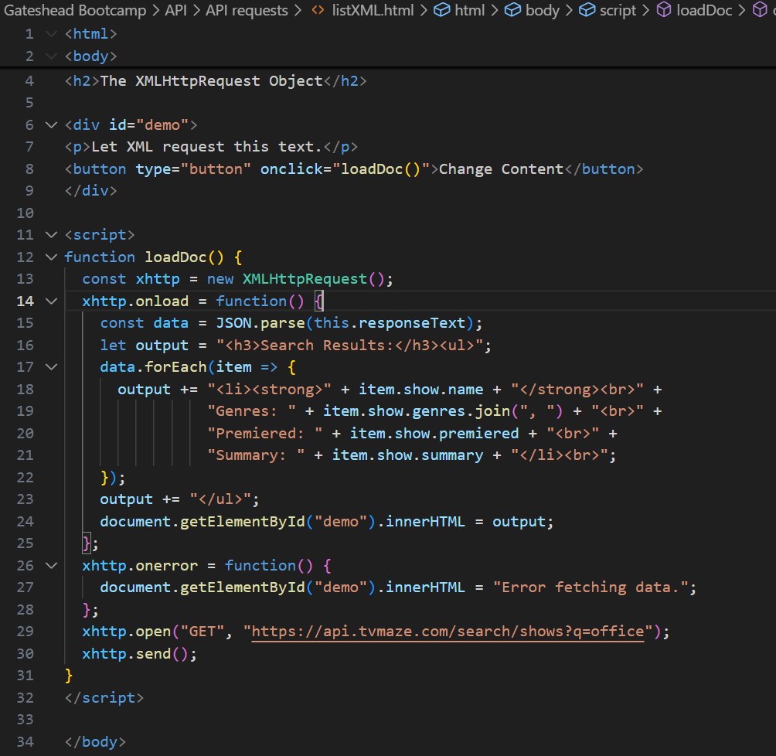
Retrieving
This is an advancement from the previous slide as we are now dealing with multiple results by using for each and unordered lists for better handling.

Slide 5
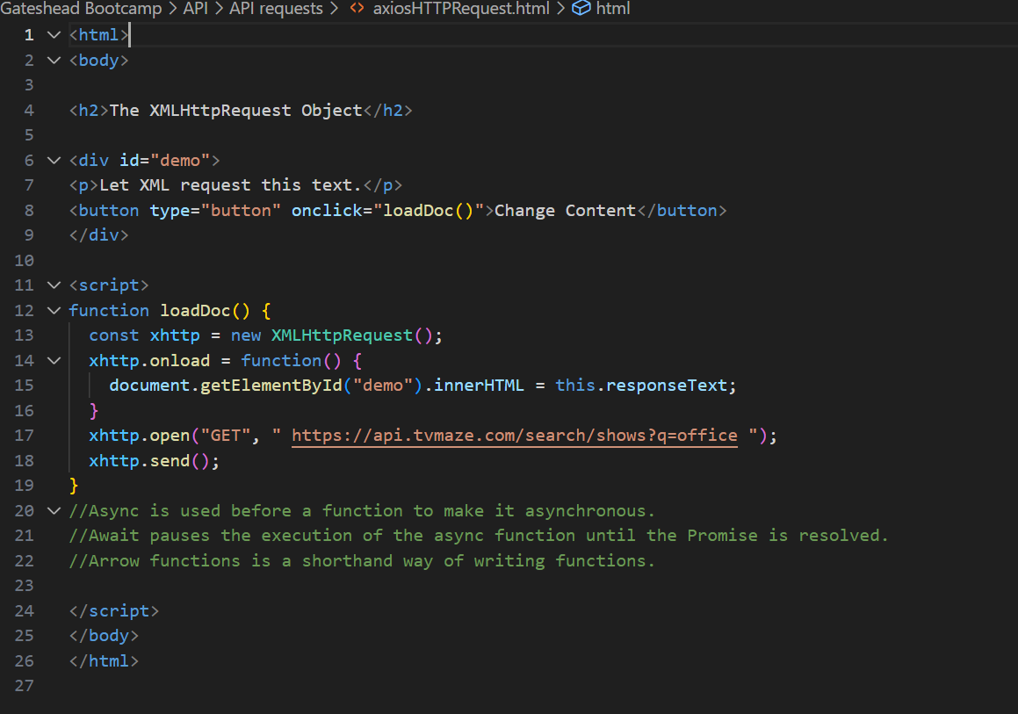
Axios
This now doesn’t use Xmlhttp requests and use fecth api instead. Using functions like fetch(file) which immediately returns a promise which is converted to text and this text is added to div via the add TEXT FUNCTION.

Slide 6
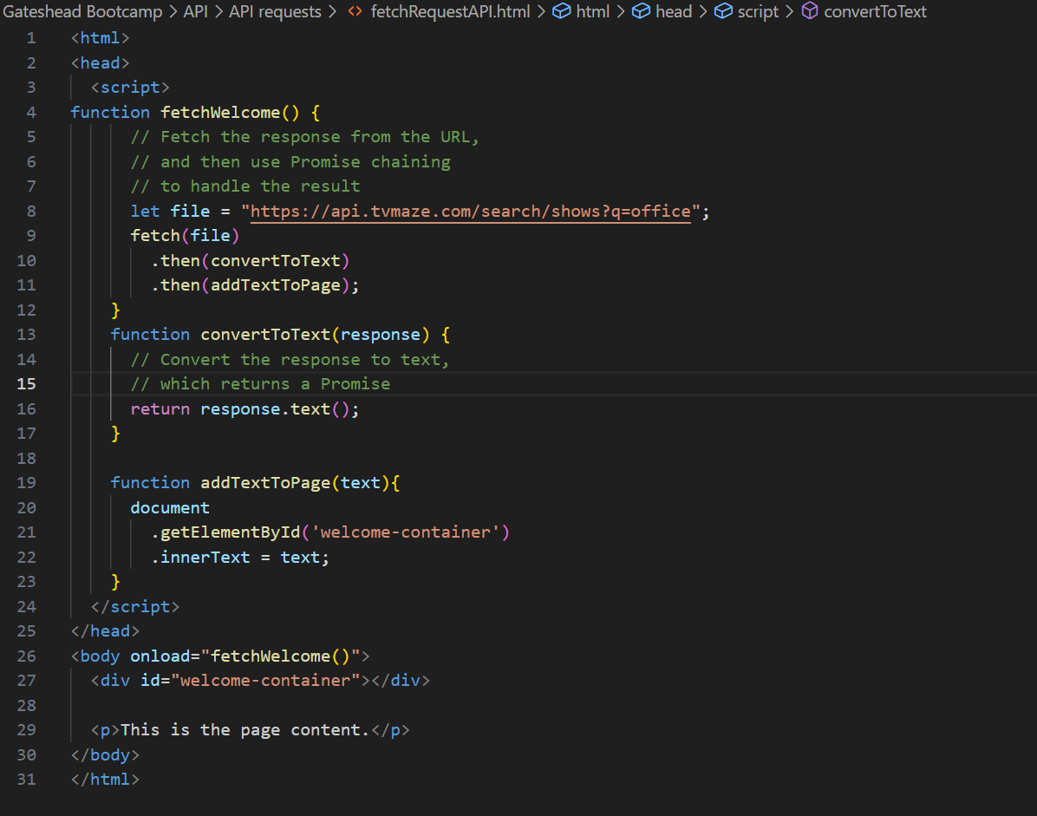
Axios
This fetch is more efficient as it uses more direct chaining without variables for a more concise and cleaner code.

Slide 7
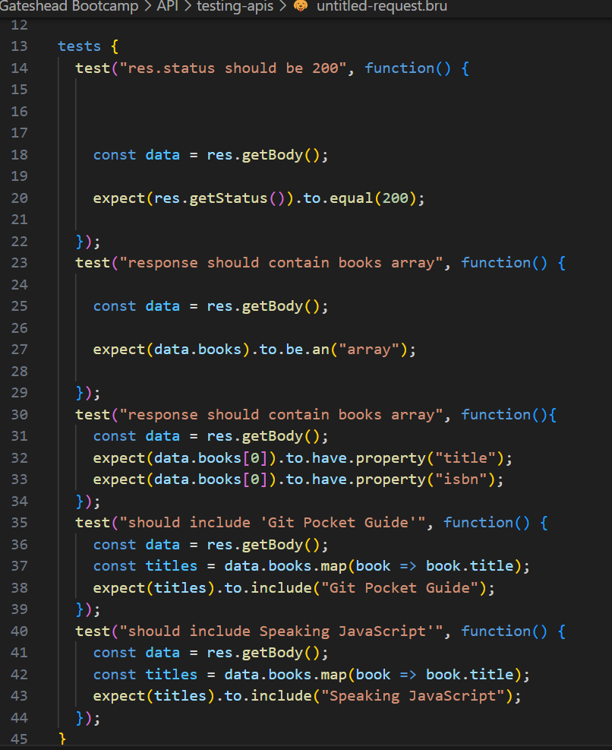
Testing
This is a test suite for an api and contains multiple test. This tests many things like the http status, if it contains an array and if certain specific books exist and more. Thos was done in the Bruno extension in vscode.

Slide 8
Definitions
Async is used before a function to make it asynchronous.
Await pauses the execution of the async function until the Promise is resolved.
Arrow functions is a shorthand way of writing functions.
API(Application Programming interface) is a set of methods ,classes and protocols that allow different software to communicate with each other. This allows other developers to use predefined functionalities without delving into internal implementation.
Bruno is used for sending requests, user-friendly interface, api testing and file storage.

